Slide 1
Hashing
Mahdi Ebrahimi
Summer 2020

Slide 2
hash tables

Slide 3
Fundamentals
Define m target addresses (the "buckets")
Create a hash function h(k) that is defined for all possible values of the key k and returns an integer value h such that 0 ≤ h ≤ m – 1
h(k)
Key

Slide 4
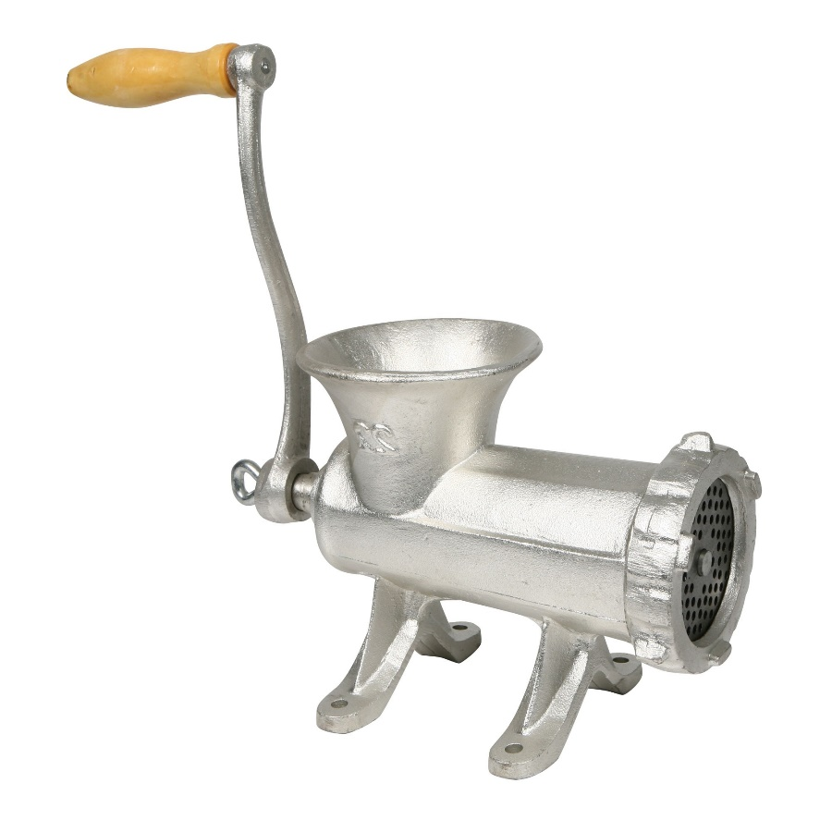
The idea
Key
Hash value is Bucket address

Slide 5
Hash Tables
A hash table is an array of some fixed size
Basic idea:
The goal:
Aim for constant-time find, insert, and delete "on average" under reasonable assumptions
hash table
0
 | ⁞
size -1
hash function:
index = h(key)
key space (e.g., integers, strings)

Slide 6
An Ideal Hash Functions
Is fast to compute
Rarely hashes two keys to the same index
Known as collisions
Zero collisions often impossible in theory but reasonably achievable in practice
0
 | ⁞
size -1
hash function:
index = h(key)
key space (e.g., integers, strings)

Slide 7
What to Hash?
We will focus on two most common things to hash: ints and strings
If you have objects with several fields, it is usually best to hash most of the "identifying fields" to avoid collisions:
class Person { String firstName, middleName, lastName;
Date birthDate;
…
}
An inherent trade-off:
hashing-time vs. collision-avoidance
use these four values

Slide 8
Hashing Integers
key space = integers
Simple hash function:
h(key) = key % TableSize
Client: f(x) = x
Library: g(x) = f(x) % TableSize
Fairly fast and natural
Example:
TableSize = 10
Insert keys 7, 18, 41, 34, 10
0
1
2
3
4
5
6
7
8
9
10
41
34
7
18
Notes:
Note that we are ignoring the data associated with the keys

Slide 9
Hashing non-integer keys
If keys are not ints, the client must provide a means to convert the key to an int
Programming Trade-off:
Calculation speed
Avoiding distinct keys hashing to same ints

Slide 10

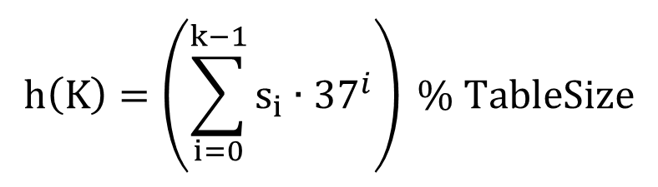
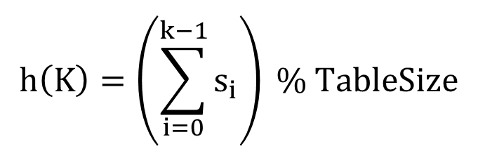
Hashing Strings
Key space K = s₀s₁s₂…s_{k-1} where s_{i} are chars: s_{i} ∈ [0, 256]
Some choices: Which ones best avoid collisions?
$$h\left(K\right)=\left(s_{0}\right) \% TableSize$$
$$h\left(K\right)=\left(\sum_{i=0}^{k−1}{s_{i}}\right) \% TableSize$$
$$h\left(K\right)=\left(\sum_{i=0}^{k−1}{s_{i}∙{37}^{i}}\right) \% TableSize$$

Slide 11
Collision Resolution

Slide 12
Collision Avoidance
With (x%TableSize), number of collisions depends on
the ints inserted
TableSize
Larger table-size tends to help, but not always
Example: 70, 24, 56, 43, 10 with TableSize = 10 and TableSize = 60

Slide 13
Collision Resolution
Collision:
When two keys map to the same location in the hash table
We try to avoid it, but the number of keys always exceeds the table size
Hash tables generally must support some form of collision resolution

Slide 14
Flavors of Collision Resolution
Separate Chaining
Open Addressing
Linear Probing
Quadratic Probing
Double Hashing

Slide 15

Terminology Warning
We and the book use the terms
"chaining" or "separate chaining"
"open addressing"
Very confusingly, others use the terms
"open hashing" for "chaining"
"closed hashing" for "open addressing"
We also do trees upside-down

Slide 16
Separate Chaining
All keys that map to the same table location are kept in a linked list (a.k.a. a "chain" or "bucket")
As easy as it sounds
Example: insert 10, 22, 86, 12, 42 with h(x) = x % 10
0 | /
1 | /
2 | /
3 | /
4 | /
5 | /
6 | /
7 | /
8 | /
9 | /

Slide 17
Separate Chaining
All keys that map to the same table location are kept in a linked list (a.k.a. a "chain" or "bucket")
As easy as it sounds
Example: insert 10, 22, 86, 12, 42 with h(x) = x % 10
0
1 | /
2 | /
3 | /
4 | /
5 | /
6 | /
7 | /
8 | /
9 | /
10
/

Slide 18
Separate Chaining
All keys that map to the same table location are kept in a linked list (a.k.a. a "chain" or "bucket")
As easy as it sounds
Example: insert 10, 22, 86, 12, 42 with h(x) = x % 10
0
1 | /
2
3 | /
4 | /
5 | /
6 | /
7 | /
8 | /
9 | /
10
/
22
/

Slide 19
Separate Chaining
All keys that map to the same table location are kept in a linked list (a.k.a. a "chain" or "bucket")
As easy as it sounds
Example: insert 10, 22, 86, 12, 42 with h(x) = x % 10
0
1 | /
2
3 | /
4 | /
5 | /
6
7 | /
8 | /
9 | /
10
/
22
/
86
/

Slide 20
Separate Chaining
All keys that map to the same table location are kept in a linked list (a.k.a. a "chain" or "bucket")
As easy as it sounds
Example: insert 10, 22, 86, 12, 42 with h(x) = x % 10
0
1 | /
2
3 | /
4 | /
5 | /
6
7 | /
8 | /
9 | /
10
/
12
22
/
86
/

Slide 21
Separate Chaining
All keys that map to the same table location are kept in a linked list (a.k.a. a "chain" or "bucket")
As easy as it sounds
Example: insert 10, 22, 86, 12, 42 with h(x) = x % 10
0
1 | /
2
3 | /
4 | /
5 | /
6
7 | /
8 | /
9 | /
10
/
42
12
22
/
86
/

Slide 22
Thoughts on Separate Chaining
Worst-case time for find?
Linear
But only with really bad luck or bad hash function
Beyond asymptotic complexity, some "data-structure engineering" can improve constant factors
Linked list, array, or a hybrid
Insert at end or beginning of list
Sorting the lists gains and loses performance
Splay-like: Always move item to front of list

Slide 23

Rigorous Separate Chaining Analysis
The load factor, λ, of a hash table is calculated as
$$λ=\frac{n}{TableSize}$$
where n is the number of items currently in the table

Slide 24
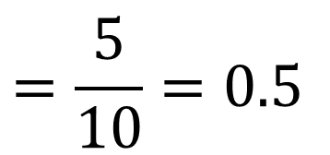
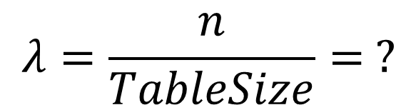
Load Factor?
0
1 | /
2
3 | /
4 | /
5 | /
6
7 | /
8 | /
9 | /
10
/
42
12
22
/
86
/
$$λ=\frac{n}{TableSize}= ?$$
$$=\frac{5}{10}=0.5$$

Slide 25
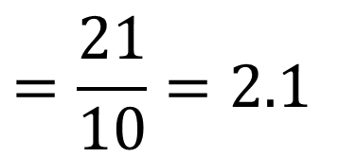
Load Factor?
0
1
2
3
4 | /
5
6
7
8
9
10
/
71
2
31
/
42
12
22
/
63
73
/
75
5
65
95
/
86
/
27
47
88
18
38
98
/
99
/
$$=\frac{21}{10}=2.1$$
$$λ=\frac{n}{TableSize}= ?$$

Slide 26
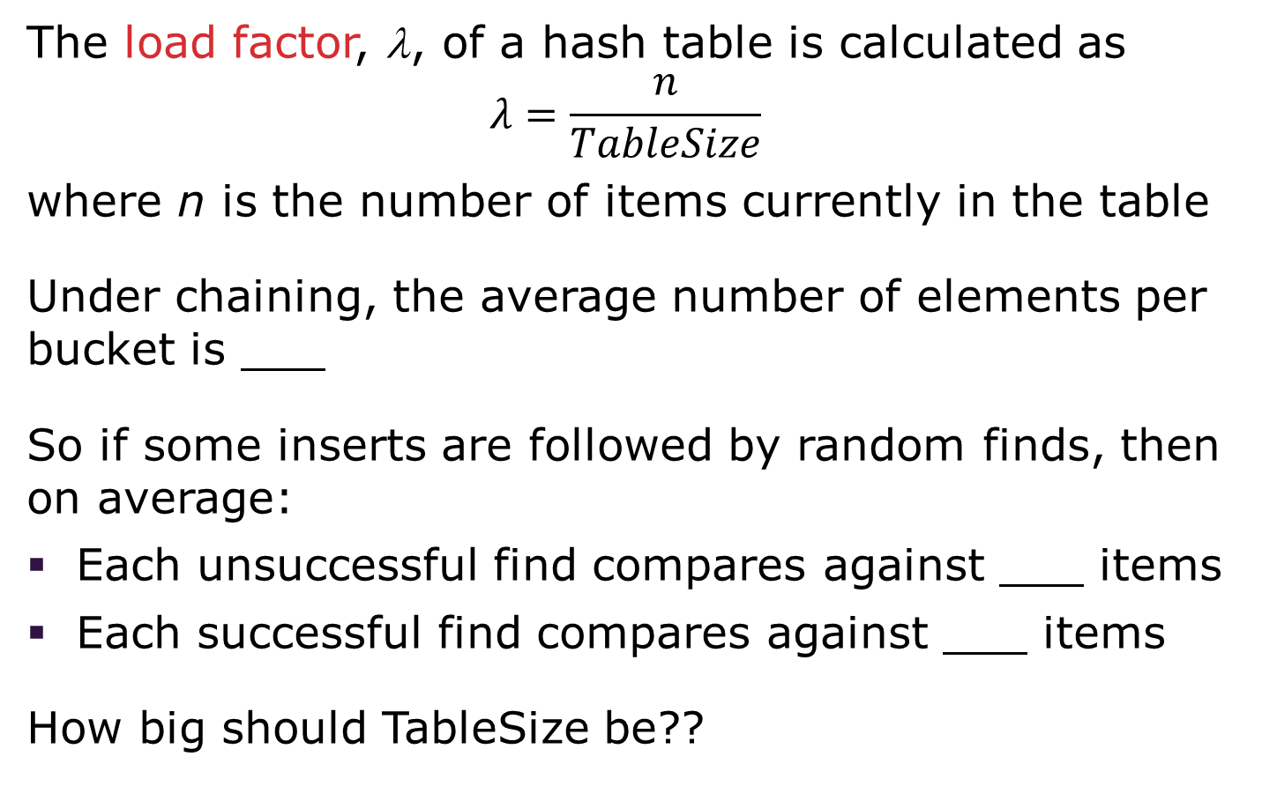
Rigorous Separate Chaining Analysis
The load factor, λ, of a hash table is calculated as
$$λ=\frac{n}{TableSize}$$ where n is the number of items currently in the table
Under chaining, the average number of elements per bucket is ___
So if some inserts are followed by random finds, then on average:
Each unsuccessful find compares against ___ items
Each successful find compares against ___ items
How big should TableSize be??

Slide 27
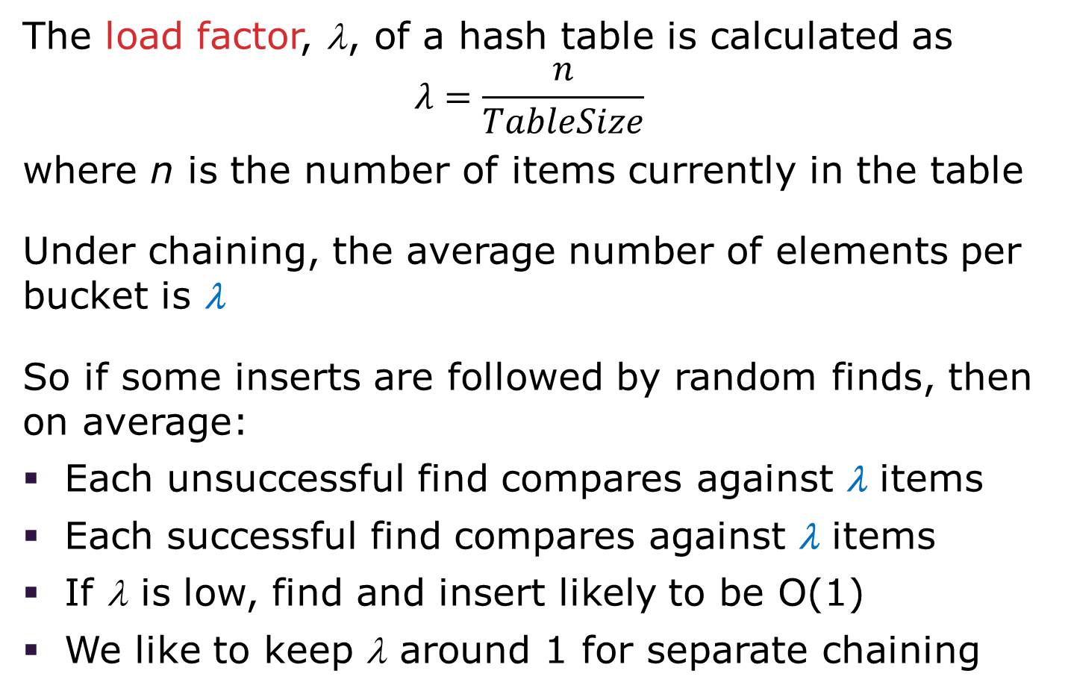
Rigorous Separate Chaining Analysis
The load factor, λ, of a hash table is calculated as
$$λ=\frac{n}{TableSize}$$ where n is the number of items currently in the table
Under chaining, the average number of elements per bucket is λ
So if some inserts are followed by random finds, then on average:
Each unsuccessful find compares against λ items
Each successful find compares against λ items
If λ is low, find and insert likely to be O(1)
We like to keep λ around 1 for separate chaining
Notes:
λ is the Greek lowercase lambda

Slide 28
Separate Chaining Deletion
Not too bad and quite easy
Find in table
Delete from bucket
Similar run-time as insert
0
1 | /
2
3 | /
4 | /
5 | /
6
7 | /
8 | /
9 | /
10
/
42
12
22
/
86
/

Slide 29
Open Addressing: Linear Probing
Separate chaining does not use all the space in the table. Why not use it?
Store directly in the array cell
No linked lists or buckets
How to deal with collisions?
If h(key) is already full,
try (h(key) + 1) % TableSize. If full,
try (h(key) + 2) % TableSize. If full,
try (h(key) + 3) % TableSize. If full…
Example: insert 38, 19, 8, 79, 10
0
1
2
3
4
5
6
7
8
9

Slide 30
Open Addressing: Linear Probing
Separate chaining does not use all the space in the table. Why not use it?
Store directly in the array cell (no linked list or buckets)
How to deal with collisions?
If h(key) is already full,
try (h(key) + 1) % TableSize. If full,
try (h(key) + 2) % TableSize. If full,
try (h(key) + 3) % TableSize. If full…
Example: insert 38, 19, 8, 79, 10
0
1
2
3
4
5
6
7
8 | 38
9

Slide 31
Open Addressing: Linear Probing
Separate chaining does not use all the space in the table. Why not use it?
Store directly in the array cell (no linked list or buckets)
How to deal with collisions?
If h(key) is already full,
try (h(key) + 1) % TableSize. If full,
try (h(key) + 2) % TableSize. If full,
try (h(key) + 3) % TableSize. If full…
Example: insert 38, 19, 8, 79, 10
0
1
2
3
4
5
6
7
8 | 38
9 | 19

Slide 32
Open Addressing: Linear Probing
Separate chaining does not use all the space in the table. Why not use it?
Store directly in the array cell (no linked list or buckets)
How to deal with collisions?
If h(key) is already full,
try (h(key) + 1) % TableSize. If full,
try (h(key) + 2) % TableSize. If full,
try (h(key) + 3) % TableSize. If full…
Example: insert 38, 19, 8, 79, 10
0 | 8
1
2
3
4
5
6
7
8 | 38
9 | 19

Slide 33
Open Addressing: Linear Probing
Separate chaining does not use all the space in the table. Why not use it?
Store directly in the array cell (no linked list or buckets)
How to deal with collisions?
If h(key) is already full,
try (h(key) + 1) % TableSize. If full,
try (h(key) + 2) % TableSize. If full,
try (h(key) + 3) % TableSize. If full…
Example: insert 38, 19, 8, 79, 10
0 | 8
1 | 79
2
3
4
5
6
7
8 | 38
9 | 19

Slide 34
Open Addressing: Linear Probing
Separate chaining does not use all the space in the table. Why not use it?
Store directly in the array cell (no linked list or buckets)
How to deal with collisions?
If h(key) is already full,
try (h(key) + 1) % TableSize. If full,
try (h(key) + 2) % TableSize. If full,
try (h(key) + 3) % TableSize. If full…
Example: insert 38, 19, 8, 79, 10
0 | 8
1 | 79
2 | 10
3
4
5
6
7
8 | 38
9 | 19

Slide 35
Load Factor?
0 | 8
1 | 79
2 | 10
3
4
5
6
7
8 | 38
9 | 19
Can the load factor when using linear probing ever exceed 1.0?
Nope!!
$$λ=\frac{n}{TableSize}= ?$$
$$=\frac{5}{10}=0.5$$

Slide 36
Open Addressing in General
This is one example of open addressing
Open addressing means resolving collisions by trying a sequence of other positions in the table
Trying the next spot is called probing
We just did linear probing h(key) + i) % TableSize
In general have some probe function f and use h(key) + f(i) % TableSize
Open addressing does poorly with high load factor λ
So we want larger tables
Too many probes means we lose our O(1)

Slide 37
Open Addressing: Other Operations
insert finds an open table position using a probe function
What about find?
Must use same probe function to "retrace the trail" for the data
Unsuccessful search when reach empty position
What about delete?
Must use "lazy" deletion. Why?
Marker indicates "data was here, keep on probing"
10 | ✗ | / | 23 | / | / | 16 | ✗ | 26

Slide 38
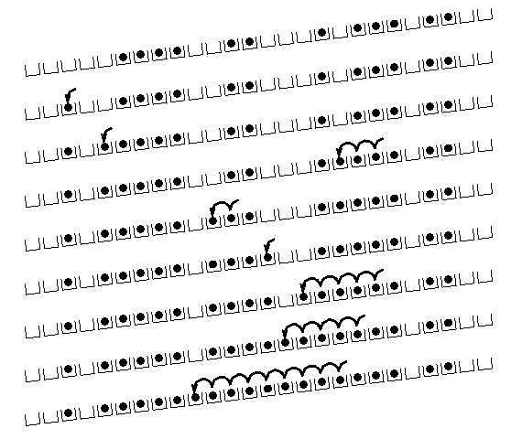
Primary Clustering
It turns out linear probing is a bad idea, even though the probe function is quick to compute (which is a good thing)
This tends to produce clusters, which lead to long probe sequences
This is called primary clustering
We saw the start of a cluster in our linear probing example
[R. Sedgewick]

Slide 39
Open Addressing: Quadratic Probing
We can avoid primary clustering by changing the probe function from just i to f(i)
(h(key) + f(i)) % TableSize
For quadratic probing, f(i) = i²:
0th probe: (h(key) + 0) % TableSize
1st probe: (h(key) + 1) % TableSize
2nd probe: (h(key) + 4) % TableSize
3rd probe: (h(key) + 9) % TableSize
…
i^{th} probe: (h(key) + i²) % TableSize
Intuition: Probes quickly "leave the neighborhood"

Slide 40
Quadratic Probing Example
TableSize = 10
insert(89)
0
1
2
3
4
5
6
7
8
9

Slide 41
Quadratic Probing Example
TableSize = 10
insert(89)
insert(18)
0
1
2
3
4
5
6
7
8
9 | 89

Slide 42
Quadratic Probing Example
TableSize = 10
insert(89)
insert(18)
insert(49)
0
1
2
3
4
5
6
7
8 | 18
9 | 89

Slide 43
Quadratic Probing Example
TableSize = 10
insert(89)
insert(18)
insert(49)
49 % 10 = 9 collision!
(49 + 1) % 10 = 0
insert(58)
0 | 49
1
2
3
4
5
6
7
8 | 18
9 | 89

Slide 44
Quadratic Probing Example
TableSize = 10
insert(89)
insert(18)
insert(49)
insert(58)
58 % 10 = 8 collision!
(58 + 1) % 10 = 9 collision!
(58 + 4) % 10 = 2
insert(79)
0 | 49
1
2 | 58
3
4
5
6
7
8 | 18
9 | 89

Slide 45
Quadratic Probing Example
TableSize = 10
insert(89)
insert(18)
insert(49)
insert(58)
insert(79)
79 % 10 = 9 collision!
(79 + 1) % 10 = 0 collision!
(79 + 4) % 10 = 3
0 | 49
1
2 | 58
3 | 79
4
5
6
7
8 | 18
9 | 89

Slide 46
Another Quadratic Probing Example
TableSize = 7
Insert:
76 (76 % 7 = 6)
40 (40 % 7 = 5)
48 (48 % 7 = 6)
5 (5 % 7 = 5)
55 (55 % 7 = 6)
47 (47 % 7 = 5)
0
1
2
3
4
5
6

Slide 47
Another Quadratic Probing Example
TableSize = 7
Insert:
76 (76 % 7 = 6)
40 (40 % 7 = 5)
48 (48 % 7 = 6)
5 (5 % 7 = 5)
55 (55 % 7 = 6)
47 (47 % 7 = 5)
0
1
2
3
4
5
6 | 76

Slide 48
Another Quadratic Probing Example
TableSize = 7
Insert:
76 (76 % 7 = 6)
40 (40 % 7 = 5)
48 (48 % 7 = 6)
5 (5 % 7 = 5)
55 (55 % 7 = 6)
47 (47 % 7 = 5)
0
1
2
3
4
5 | 40
6 | 76

Slide 49
Another Quadratic Probing Example
TableSize = 7
Insert:
76 (76 % 7 = 6)
40 (40 % 7 = 5)
48 (48 % 7 = 6)
5 (5 % 7 = 5)
55 (55 % 7 = 6)
47 (47 % 7 = 5)
0 | 48
1
2
3
4
5 | 40
6 | 76

Slide 50
Another Quadratic Probing Example
TableSize = 7
Insert:
(76 % 7 = 6)
(40 % 7 = 5)
48 (48 % 7 = 6)
5 (5 % 7 = 5)
55 (55 % 7 = 6)
47 (47 % 7 = 5)
0 | 48
1
2 | 5
3
4
5 | 40
6 | 76

Slide 51
Another Quadratic Probing Example
TableSize = 7
Insert:
76 (76 % 7 = 6)
40 (40 % 7 = 5)
48 (48 % 7 = 6)
5 (5 % 7 = 5)
55 (55 % 7 = 6)
47 (47 % 7 = 5)
0 | 48
1
2 | 5
3 | 55
4
5 | 40
6 | 76

Slide 52
Another Quadratic Probing Example
TableSize = 7
Insert:
76 (76 % 7 = 6)
40 (40 % 7 = 5)
48 (48 % 7 = 6)
5 (5 % 7 = 5)
55 (55 % 7 = 6)
47 (47 % 7 = 5)
(47 + 1) % 7 = 6 collision!
(47 + 4) % 7 = 2 collision!
(47 + 9) % 7 = 0 collision!
(47 + 16) % 7 = 0 collision!
(47 + 25) % 7 = 2 collision!
0 | 48
1
2 | 5
3 | 55
4
5 | 40
6 | 76
Will we ever get a 1 or 4?!?

Slide 53
Another Quadratic Probing Example
insert(47) will always fail here. Why?
For all n, (5 + n²) % 7 is 0, 2, 5, or 6
Proof uses induction and
(5 + n²) % 7 = (5 + (n - 7)²) % 7
In fact, for all c and k,
(c + n²) % k = (c + (n - k)²) % k
0 | 48
1
2 | 5
3 | 55
4
5 | 40
6 | 76

Slide 54
From Bad News to Good News
After TableSize quadratic probes, we cycle through the same indices
The good news:
For prime T and 0 ≤ i, j ≤ T/2 where i ≠ j, (h(key) + i²) % T ≠ (h(key) + j²) % T
If TableSize is prime and λ < ½, quadratic probing will find an empty slot in at most TableSize/2 probes
If you keep λ < ½, no need to detect cycles as we just saw

Slide 55
Clustering Reconsidered
Quadratic probing does not suffer from primary clustering as the quadratic nature quickly escapes the neighborhood
But it is no help if keys initially hash the same index
Any 2 keys that hash to the same value will have the same series of moves after that
Called secondary clustering
We can avoid secondary clustering with a probe function that depends on the key: double hashing

Slide 56
Open Addressing: Double Hashing
Idea:
Given two good hash functions h and g, it is very unlikely that for some key, h(key) == g(key)
Why not probe using g(key)?
For double hashing, f(i) = i ⋅ g(key):
0th probe: (h(key) + 0 ⋅ g(key)) % TableSize
1st probe: (h(key) + 1 ⋅ g(key)) % TableSize
2nd probe: (h(key) + 2 ⋅ g(key)) % TableSize
…
i^{th} probe: (h(key) + i ⋅ g(key)) % TableSize
Crucial Detail:
We must make sure that g(key) cannot be 0

Slide 57
Double Hashing
T = 10 (TableSize)
Hash Functions:
h(key) = key mod T
g(key) = 1 + ((key/T) mod (T-1))
0
1
2
3
4
5
6
7
8
9
Insert these values into the hash table in this order. Resolve any collisions with double hashing:
13
28
33
147
43

Slide 58
Double Hashing
T = 10 (TableSize)
Hash Functions:
h(key) = key mod T
g(key) = 1 + ((key/T) mod (T-1))
0
1
2
3 | 13
4
5
6
7
8
9
Insert these values into the hash table in this order. Resolve any collisions with double hashing:
13
28
33
147
43

Slide 59
Double Hashing
T = 10 (TableSize)
Hash Functions:
h(key) = key mod T
g(key) = 1 + ((key/T) mod (T-1))
0
1
2
3 | 13
4
5
6
7
8 | 28
9
Insert these values into the hash table in this order. Resolve any collisions with double hashing:
13
28
33
147
43

Slide 60
Double Hashing
T = 10 (TableSize)
Hash Functions:
h(key) = key mod T
g(key) = 1 + ((key/T) mod (T-1))
0
1
2
3 | 13
4
5
6
7 | 33
8 | 28
9
Insert these values into the hash table in this order. Resolve any collisions with double hashing:
13
28
33 → g(33) = 1 + 3 mod 9 = 4
147
43

Slide 61
Double Hashing
T = 10 (TableSize)
Hash Functions:
h(key) = key mod T
g(key) = 1 + ((key/T) mod (T-1))
0
1
2
3 | 13
4
5
6
7 | 33
8 | 28
9 | 147
Insert these values into the hash table in this order. Resolve any collisions with double hashing:
13
28
33
147 → g(147) = 1 + 14 mod 9 = 6
43

Slide 62
Double Hashing
T = 10 (TableSize)
Hash Functions:
h(key) = key mod T
g(key) = 1 + ((key/T) mod (T-1))
0
1
2
3 | 13
4
5
6
7 | 33
8 | 28
9 | 147
Insert these values into the hash table in this order. Resolve any collisions with double hashing:
13
28
33
147 → g(147) = 1 + 14 mod 9 = 6
43 → g(43) = 1 + 4 mod 9 = 5
We have a problem:
3 + 0 = 3 3 + 5 = 8 3 + 10 = 13 3 + 15 = 18 3 + 20 = 23

Slide 63
Double Hashing Analysis
Because each probe is "jumping" by g(key) each time, we should ideally "leave the neighborhood" and "go different places from the same initial collision"
But, as in quadratic probing, we could still have a problem where we are not "safe" due to an infinite loop despite room in table
This cannot happen in at least one case:
For primes p and q such that 2 < q < p
h(key) = key % p
g(key) = q – (key % q)

Slide 64
Summarizing Collision Resolution
Separate Chaining is easy
find, delete proportional to load factor on average
insert can be constant if just push on front of list
Open addressing uses probing, has clustering issues as it gets full but still has reasons for its use:
Easier data representation
Less memory allocation
Run-time overhead for list nodes (but an array implementation could be faster)

Slide 65
Rehashing

Slide 66
Rehashing
As with array-based stacks/queues/lists
If table gets too full, create a bigger table and copy everything
Less helpful to shrink a table that is underfull
With chaining, we get to decide what "too full" means
Keep load factor reasonable (e.g., < 1)?
Consider average or max size of non-empty chains
For open addressing, half-full is a good rule of thumb

Slide 67
Rehashing
What size should we choose?
Twice-as-big?
Except that won’t be prime!
We go twice-as-big but guarantee prime
Implement by hard coding a list of prime numbers
You probably will not grow more than 20-30 times and can then calculate after that if necessary

Slide 68
Rehashing
Can we copy all data to the same indices in the new table?
Will not work; we calculated the index based on TableSize
Rehash Algorithm:
Go through old table
Do standard insert for each item into new table
Resize is an O(n) operation,
Iterate over old table: O(n)
n inserts / calls to the hash function: n ⋅ O(1) = O(n)
Is there some way to avoid all those hash function calls?
Space/time tradeoff: Could store h(key) with each data item
Growing the table is still O(n); only helps by a constant factor

Slide 69
Final Word on Hashing
The hash table is one of the most important data structures
Efficient find, insert, and delete
Operations based on sorted order are not so efficient
Useful in many, many real-world applications
Popular topic for job interview questions
Important to use a good hash function
Good distribution of key hashs
Not overly expensive to calculate (bit shifts good!)
Important to keep hash table at a good size
Keep TableSize a prime number
Set a preferable λ depending on type of hashtable

